Slide 1
Blooms Taxonomy
A Taxonomy is an arrangement of ideas or a way to
group things together , Named after the creator, Benjamin Bloom.
You may see the levels organized differently in
other charts

Slide 2
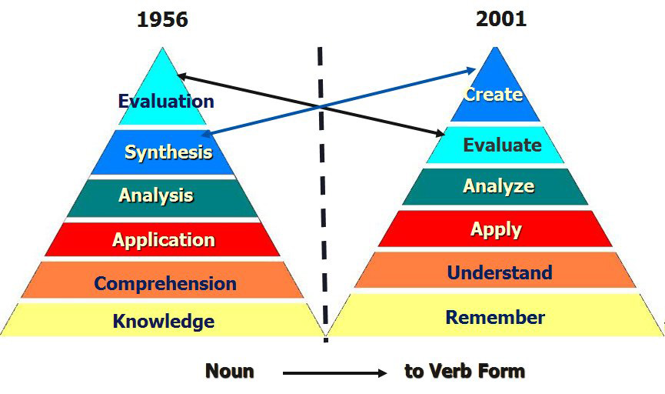
Six levels of cognitive domain objectives

Slide 3
Knowledge or Remembering
Observation and recall of information
Knowledge of dates, events, places
Knowledge of major ideas
Mastery of subject matter
Key words list - define, tell, describe,
identify, show, label, collect, examine,
tabulate, quote, name, who, when, where, etc.

Slide 4
Comprehension or Understanding
Understanding information
Grasp meaning
Translate knowledge into new context
Interpret facts, compare, contrast
Order, group, infer causes
Predict consequences
Key words - summarize, describe, interpret,
contrast, predict, associate, distinguish,
estimate, differentiate, discuss, extend

Slide 5
Application or Applying
Use information
Use methods, concepts, theories in new situations
solve problems using required skills or knowledge
Key words - apply, demonstrate, calculate,
complete, illustrate, show, solve, examine,
modify, relate, change, classify, experiment,

Slide 6
Analysis or Analyzing
Seeing patterns
Organization of parts
Recognition of hidden meanings
Identification of components
Key words - analyze, separate, order, explain,
connect, classify, arrange, divide, compare,
select, explain, infer.

Slide 7
Synthesis or Creating
Use old ideas to create new ones
Generalize from given facts
Relate knowledge from several areas
Predict, draw conclusions
Key words - combine, integrate, modify, rearrange,
substitute, plan, create, design, invent, what
if?, compose, formulate, prepare, generalize,
rewrite

Slide 8
Evaluation or Evaluating
Compare and discriminate between ideas
Assess value of theories, presentations
Make choices based on reasoned argument
Verify value of evidence
Recognize subjectivity
Key words - assess, decide, rank, grade, test,
measure, recommend, convince, select, judge,
explain, discriminate, support, conclude,
compare, summarize

Slide 9
Thank you

